Slide 1
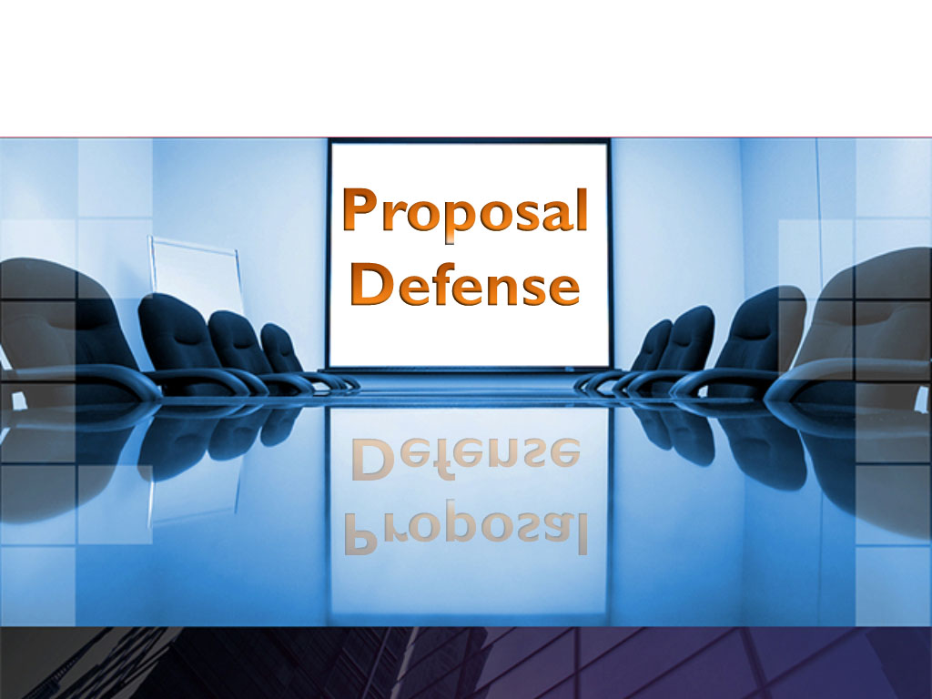

Slide 2
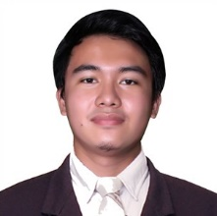
Researcher’s Profile
GIL CHRISTIAN C. ALVAREZ
B2L19 Princetown Subd., Bagumbong, Caloocan City
0955-391-8395
gcalvarez@vas.ph
Skills
Knowledgeable in C, Java, MySQL, PHP, HTML, CSS, Bootstrap, Node.js, Python, JavaScript, Arduino, Linux Server Administration, and Digital Electronics.
Knowledgeable in Diagram and Schematic Designing.
Projects Done
Crop Yield Prediction System using Machine Learning (tanim-analytics.xyz)
Lead Developer
Oct 2021 – Feb 2022
Vulgar Words Censorship using Regular Expressions (halaanongsabimo.xyz)
Lead Developer
Mar 2022 – Jul 2022

Slide 3
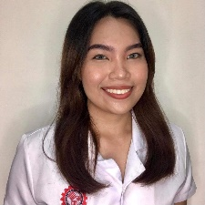
Researcher’s Profile
ALEXANDRA JULIAN DE GUZMAN
Blk 31 Lt 22 Milkworth St. Primarosa Subdivision Barangay Mambog 3,
Bacoor, Cavite
09052322292
alex.dg0815@gmail.com
Skills
Knowledgeable in C, C++, Java, MySQL, MongoDB, HTML, CSS, PHP, Node.js, JavaScript, and Arduino.
Knowledgeable in editing creative materials and videos
Knowledgeable in using Microsoft software.
Projects Done
E-Commerce Platform with Augmented Reality Developer
Mar 2022 – Aug 2022
Simulation and Analysis of Alabang- Zapote Road Traffic Flow
Developer
Mar 2022 – Aug 2022

Slide 4
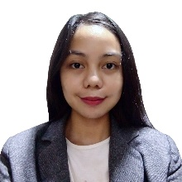
Researcher’s Profile
RIO LALAINE L. PANO
356 Kalawaan St. Darangan Binangonan, Rizal
0968-601-3796
rlaine193@gmail.com
Skills
Knowledgeable in C, C++, Java, MySQL, HTML, CSS, Bootstrap, Node.js, and Arduino.
Knowledgeable in multi-media editing using Microsoft Windows Programs.
Projects Done
Cool Off (Website Project)
Developer
Oct 2021 – Feb 2022
Classification of the Type of Brain Tumor in MRI using Deep Learning
Developer
Feb 2022 – Jul 2022

Slide 5
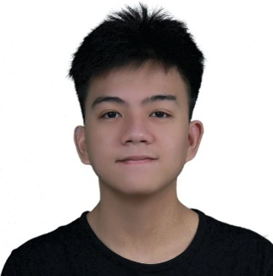
Researcher’s Profile
VINCE BRYAN B. PIÑON
Block 3 Lot 4 Patibay Uno Sitio Kaliwa, Batasan Hills QC
09565120447
bryanvincepinon@gmail.com
Skills
Knowledgeable in C, C++, Visual Basic, Java, Arduino, MySQL, HTML, CSS, Bootstrap, Node.js, PHP, and React Native.
Knowledgeable in multi-media editing using Microsoft Windows Programs.
Projects Done
Crop Yield Prediction System using Machine Learning (tanim-analytics.xyz)
Developer
October 2021 – February 2022
Vulgar Words Censorship using Regular Expressions (halaanongsabimo.xyz)
Developer
March 2022 – July 2022

Slide 6

HYDROPONICS WATER MAINTENANCE: DYNAMIC PHOSPHATE LEVEL BEHAVIOR DETECTION USING SUPERVISED CLASSIFICATION ALGORITHM

Slide 7
Background of the Study
Causes
Problems
Effects
All treatments are often carried out traditionally and there are several distinct sorts of plants
Driven to employ toxic pesticides to improve output
Plants needs a lot of water to survive
To maintain plants healthily and well-groomed, plant care is a necessary
Traditional agricultural practices put into place for soil-based harvesting
Hydroponics must carefully examine the timing of when to add water and replenish nutrients.
If the plant owner has several Hydroponic plants, this may be quite troublesome
Adverse effect on consumers over time.
It consumes a lot of water usage.
Perceived Solution:
Development of Hydroponics Water Maintenance System

Slide 8
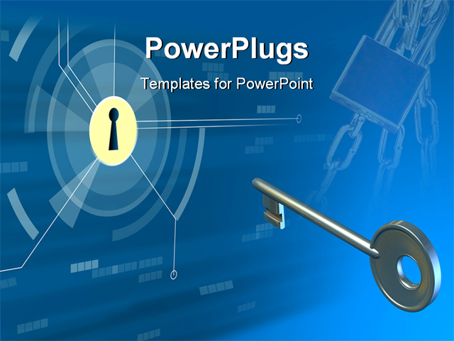
Objectives of the Study
Design a hydroponics water maintenance system with the following components:
Raspberry Pi device with the following features:
Train raw and controlled data using phosphoric acid
Emulate different phosphate levels in the water
Utilize the recorded values of a pH and Electrical Conductivity (eC)
Determine and process the phosphate levels in the water with a Machine-Learning algorithm.
Improve the longevity and free of maintenance of hydroponics
Mobile application as command interface to support the Raspberry Pi device with the following features:
Visually monitor the health of hydroponic plants
Control UV Lights
Control the water flow and its level
Control phosphate levels
Data visualization of sensor readings
Alert Notification for phosphate level of the water

Slide 9
Objectives of the Study
Develop a hydroponics water maintenance system with the following components:
Arduino device using the following tools:
Microcontroller (Arduino Uno)
Arduino Integrated Development Environment (IDE)
C Programming Language
Raspberry Pi 3b+ device using the following tools:
Raspberry Pi 3b+ ComputerNode.js
LCD Display
4 Chanel Relay Module
12 V 5A Power Supply
TDS Sensor Module
PH Sensor
Pump
Water Level Sensor
Python Programming Language

Slide 10
Objectives of the Study
c. Mobile application as command interface to support the Arduino device using the following tools:
Visual Studio Code
Android Studio
JavaScript
PHP
MySQL
Evaluate each system component's acceptability based on applicable ISO 25010 criteria such as functionality suitability, performance efficiency, compatibility, usability, reliability, maintainability, and portability.

Slide 11
Scope and Limitations
The hydroponics maintenance water system is a system that aims to enables urban hydroponics farmer to automatically regulate the delivery of nutrients to the hydroponic plant by detecting the water’s PH Level through a mobile application.
The researchers would like to include the design of Arduino Uno device that will be linked to a Raspberry Pi 3b+ to help it with the processing of the algorithm.
The Raspberry Pi 3b+ would be utilized to test raw phosphate levels in the water by training raw and controlled data using phosphoric acid.
The researcher’s design includes a TDS (Total dissolved solids) sensor to measure the eC levels of the water, as well as a PH sensor to actively measure the acidity and/or the base levels of the water.
These values then will be passed to the Raspberry Pi to be processed on our own algorithm design – having the k-NN (k-Nearest Neighbors) algorithm as the base model for it. . This will then output a considerable phosphate level that will be the basis if the system needs to flush the water to replenish the phosphate levels in it.
The design also has a water level sensor to see if there is still enough water for the plants. A UV Light will be included as well in order for the standard measure of healthy plants be supplied by a healthy dose of ultraviolet rays, occasionally set when indoors.

Slide 12
Scope and Limitations
In the current system, a mobile application will be built using Android Studio as the IDE.
An API (Application Programming Interface) will be developed and will be deployed on a cloud server to provide online remote accessibility.
Together with the said server, a MySQL installation will serve as the main database for the online communication protocol.
Said APIs will be developed in PHP, and will provide throughput for data going in and out of the system (sending commands from the Android application to the Raspberry Pi, and vice versa.)
The mobile app will be a conventional aid on a user – providing insights on planting with indoor hydroponics. If connected to the system, it will provide further controls, such as:
Hardware level controls (water pump control, UV Light switch, etc.)
Realtime sensor data
Overall health report for the hydroponic plants
Realtime live camera feed will also be available as a feature onto the mobile application, allowing remote monitoring of the user’s plants.
Visual monitoring will also enable certain key points in what is the standard for good and healthy plants.

Slide 13
Scope and Limitations
The app will also serve notifications on specific guidelines and events that happen on the system. User-determined guidelines is also possible for specific user preference for those said notifications.
The system runs on an independent 12V power supply that can be supplied from any power source or through a 12V power adapter – however, there is no built-in system that will enable portability, in the terms that the main power source goes down.
A user has an option to deploy a backup solution, e.g. UPS (Uninterruptable Power Supply) – but for systems like these, it is favorable to have a backup solution that will also enable the user to monitor the power situation for these systems, i.e., its power consumption, battery life, etc.
The major reason for this limitation is that this study will mainly focus on how Machine Learning algorithms help in modern indoor hydroponics.
The whole system will also be a part of the study on how modernly built systems like this, in presence with IoT (Internet of Things) will be in part of the technical revolution of the 21st century, focused on hydroponics.
Overall, the system will provide sufficient monitoring aid to any user that will proceed to get hydroponics indoors in order for an efficient and practical solution, as well as the ability to maintain healthy plants with minimal hassles of overlooking on daily plant status, chemical treatments, water changing cycles, and other conventional hydroponics routines.

Slide 14
Topical Outline
Hydroponics
Definition
Types of Hydroponics
Nutrient Film Technique
Deep Water Culture (DWC)
Wick System
Ebb And Flow
Drip System
Aeroponics
Phosphoric needs in Hydroponics
Hydroponic Plants
Vegetables
Fruits
Herbs
Flowers
Chemical
Water
Water Circulation
Water Level
Temperature
Hydroponic Agribusiness in the Philippines
Machine Learning
Definition
Automated Hydroponics application
K Nearest Neighbor Algorithm
Notes:
HYDROPONICS WATER MAINTENANCE: DYNAMIC PHOSPHATE LEVEL BEHAVIOR DETECTION USING SUPERVISED CLASSIFICATION ALGORITHM

Slide 15
Topical Outline
Rasberry Pi 3b+
Raspberry Pi 3B+ Hardware Components
Rasberry Pi 3b+ Programming Language
Python
Arduino
Arduino Basic Hardware Components
Arduino IDE Software
Arduino Programming Language
Arduino Peripheral Modules
Establishing Connection Between Raspberry Pi 3b+ and Arduino Device
Establishing Connection Between Raspberry Pi 3b+ and Android Application
Android Application
Definition
Language
Java Programming Language
Android Studio
Rest API
Definition
My SQL Database
PHP
Evaluation System
ISO 25010

Slide 16
Conceptual Model of the Study
INPUT
PROCESS
OUTPUT
Knowledge Requirement
k-NN algorithm processing
Proper phosphate levels on a hydroponics setup
Python, C, and Java programming
Serial communication
I2C bus communication
Low-level hardware connections
pH and eC sensors calibration
Electronic Schematic Design
Software Requirement
Arduino IDE
Visual Studio Code (Python IDE)
Python 3 Runtime
Android Studio
Linux OS
Apache Webserve
MySQL Database
PHP API
Android OS
Hardware Requirement
Desktop Computer
Linux Server
Arduino Mega
Raspberry Pi 3 B+
Jumper Cables
5V / 3A Power Supply
Raspberry Pi Model Camera 8MP
PH-4502c pH Sensor
DFROBOT TDS eC Sensor
4 Channel Relay Module w/ Optocoupler
12V DC Water Pump
12V DC UV Light
20x4 I2C LCD Screen
Digital Step Rotary Encoder
Breadboard
M/M Jumper Wires Pack
M/F Jumper Wires Pack
Analyze
Design
Develop & Debug
Test
HYDROPONICS WATER MAINTENANCE: DYNAMIC PHOSPHATE LEVEL BEHAVIOR DETECTION USING SUPERVISED CLASSIFICATION ALGORITHM
EVALUATION
Using ISO 25010 Software Quality Model

Slide 17
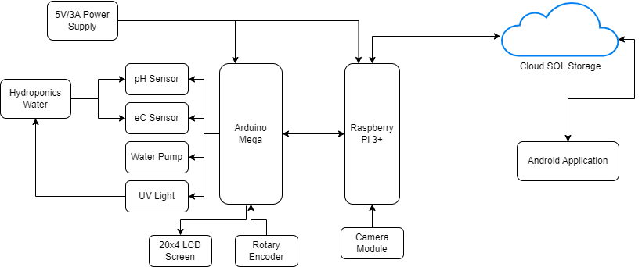
Project Design
Block Diagram of Hydroponics Water Maintenance System

Slide 18
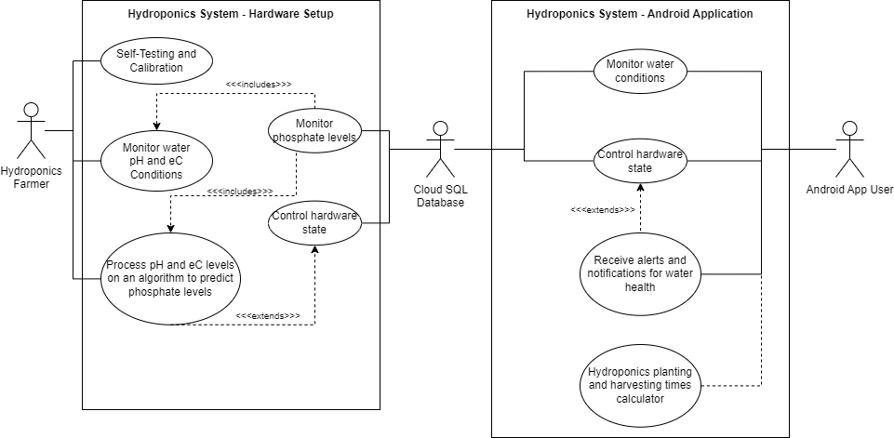
Project Design
Use Case Diagram of Hydroponics Water Maintenance System

Slide 19
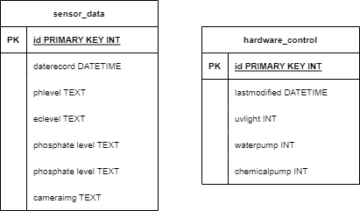
Project Design
Database Design of Hydroponics Water Maintenance System

Slide 20
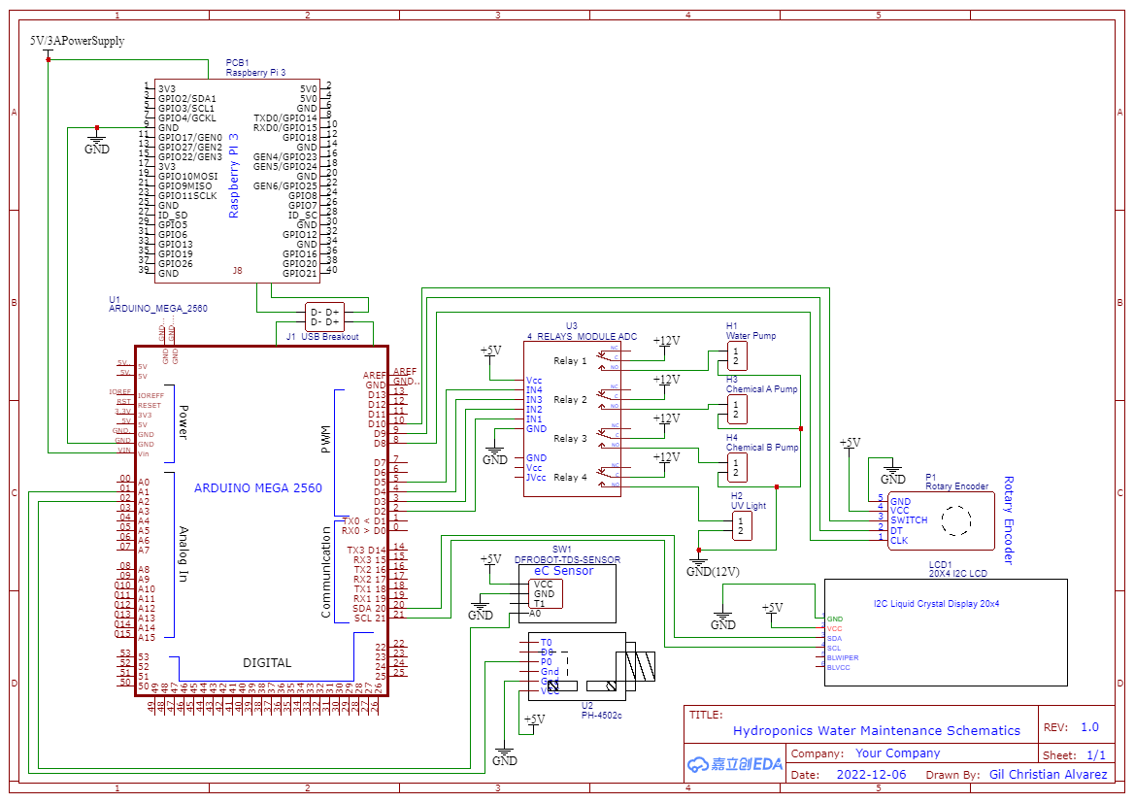
Project Development- Schematic Installation of the Arduino and Raspberry Pi
This section discusses the procedures followed on how the Hydroponics Water Maintenance system is developed based on design specifications.

Slide 21
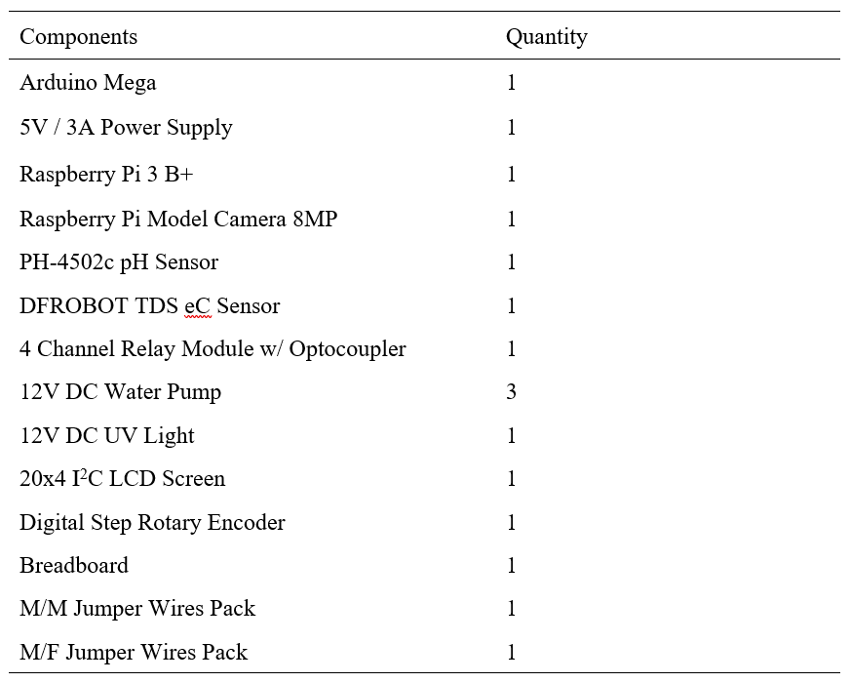
Project Development- List of Components for the Hardware of Arduino and Raspberry Pi

Slide 22
Program Coding
Cloud MySQL and PHP own API setup
Buy a Linode Linux Server to provide access to a cloud with a static IP address.
Buy a domain to point to the aforementioned static IP address.
Install LAMP Server (Linux, Apache, MySQL, PHP) in the Linux server to provide webserver capabilities.
Create the MySQL database using the Database Design in this proposal.
Create a PHP API that allows for modification and fetching from the MySQL database through POST and GET requests.
Create a separate PHP API for image uploading for the visual output of the Raspberry Pi Camera to the cloud.
Arduino Mega Setup
Input all the sensors and modules onto the Arduino using the schematic design in this proposal.
Create a selfcalibrate() function to recalibrate the pH and eC sensor. Inside this function will be handling the voltage levels of the sensors if it is in the correct 5V to 0V range, as well as setting the ADC intervals of the Arduino to 1024 levels, to provide better sensor accuracy.
Create a setupLCD() function to initialize the LCD screen itself, as well as menu and sensor displays.

Slide 23
Program Coding
4. Create a setupEncoder() function to initialize the rotary encoder as the control for the menu display. If the user pressed the rotary encoder’s button, it will trigger the menu to show up by default. If the Arduino is in the menu itself and the user pressed the rotary encoder’s button, the highlighted option will be selected. If the user turned the rotary encoder to the right, the highlighted option will be moved down – else if the user turned it in the left direction, the highlighted option will be moved up.
5. Create a setupRelays() function to initialize all relay inputs to be held digitally low (turning off its normally closed to common connection).
Create a setupSensors() function to initialize the calibrated sensors and start fetching values.
Create a displaySensors() function to display sensor values to the LCD display.
Create a sendSensorData() function to constantly send sensor data to the serial output, to be received by the Raspberry Pi.
Create a receiveOutcome() function to constantly monitor predicted phosphate levels from the Raspberry Pi.
Create a controlPumps() function to control the connected DC Water pumps (via the relays) based on the current scenario.
Create a deviceControl() function to control miscellaneous devices such as the UV Light, etc.

Slide 24
Program Coding
Create a stateMonitor() function to constantly assess the current hydroponics scenario. If the current water health / level is not favourable (influenced by the receiveOutcome() function), it will trigger the controlPumps() function to be on with specific intervals as to fulfill each of the pumps’ functions.
Create a receiveDeviceControl() function to receive device control calls from the Raspberry Pi, which in turn controls the deviceControl() function to control the UV Light, Water Pumps, etc.Create a setupSensors() function to initialize the calibrated sensors and start fetching values.
k-NN Algorithm Setup (Raspberry Pi 3+)
Prepare Python3 installation and libraries, including SKLearn, Numpy and Requests.
Import k-NN Algorithm from SKLearn library.
Setup list of datapoints from earlier gathered known sensor data from Arduino, as well as its labels (dangerous, tolerable, neutral)
Convert aforementioned datapoints into an array as well as the labels, and input them into the fit() function inside the k-NN library
Cross-check output of the algorithm against known datapoints into predict() function, and verify if revealed correct label.

Slide 25
Program Coding
Return all predicted outcomes into a single variable, and create an outputToDevice() function to output it into Arduino Mega serial input.
Using the Requests library; specifically the post() function to post data to the PHP API created to store data into the cloud SQL database.
Using the Requests library, create a getDeviceControls() function to use the get() function to fetch database triggers from the PHP API (from the Android application) to send to the Arduino Mega serial output, albeit to control certain devices.
Android Application Setup
The Android application will be programmed using Native Java, using the Android Studio IDE.
Initialize needed libraries, including the JSON library, Glide library for loading images, the Volley library for the POST and GET functions to communicated to the Cloud SQL database using the created PHP API, and all standard Android libraries (Material UI, sharedPreferences, etc.)
Create a checkInternet() function to check internet functionality of the current Android device.
Create the screen layout for the homescreen, navigating either to the sensor data or to the hydroponics planner feature.

Slide 26
Program Coding
Create the screen layout for the sensor data, as well as buttons for device controls.
Create the viewSensor() function to fetch data from the cloud database using the Volley library newRequestQueue() function.
Create the sendData() function send device control data to the cloud database using the Volley library newRequestQueue() function
Create the getLatestImage() function to fetch the latest image from the Raspberry Pi Camera module through the cloud database directly from a URL, using the Glide library load() function.
Create the screen layout for the hydroponics planner feature.
The hydroponics planner feature consists of the following features: selection of various plants to plant and selected time periods.
Create an Android service for Android notifications for the current state of the hydroponics system, as well as the hydroponics planners’ own notifications.
If the current user presses any device control buttons, it will trigger the sendData() function to send correlated user device control to the cloud SQL database, which will then be received by the Raspberry Pi.

Slide 27
Operation and Testing Procedure
The following procedure will be used to operate the Hydroponics Water Maintenance hardware system:
Install pH and eC Sensors to the corresponding water placements
Install all pumps to their corresponding water placements
Connect a LAN cable to the Raspberry Pi 3 from a source modem / router that has internet connection (and will successfully provide an IP address from its internal DHCP)
Plugin the 5V / 3A Power supply.
Wait for the LCD to stop showing “Calibrating…” on its screen.
When the sensor data shows, the user can now use the rotary encoder to operate the software menus for various operations (ie. Control the UV Light, recalibrate the system, etc.)
To test the phosphate level detection, drop 3-4mL of phosphoric acid into the water. This should trigger the phosphate level detection and clean the current water using the aforementioned pumps.
Unplug the 5V / 3A Power supply to turn off the system

Slide 28
Operation and Testing Procedure
The following procedure will be used to operate the Hydroponics Water Maintenance Android Application:
Make sure that the hardware system is turned on.
Make sure that the Android device is connected to the Internet.
Launch the Android App
Wait for the reconnection message to close down.
User should be able to see sensor data in realtime, as well as the live image feed of the hydroponics plants.
User can click buttons to control devices on the hardware itself (eg. Turning on a water pump, turning on the UV Light, etc.)
User can also use the Hydroponics Planner feature of the Android Application to plan out future hydroponics plants and provide realtime notifications in context.

Slide 29
Operation and Testing Procedure
The following table shows the testing procedures on the Hydroponics Water Maintenance system in terms of accuracy:
Water Status | Phosphate levels | Steps to be Taken | Expected Output
Dangerous | More than 100 ppm (mg/L) | Turn on the system. Drop 3-4mL of Phosphoric Acid to the water Observe System Behavior | The LCD screen will display “Dangerous” on water state and pumps will be turned on accordingly to flush out and neutralize water level immediately.

Slide 30
Operation and Testing Procedure
The following table shows the testing procedures on the Hydroponics Water Maintenance system in terms of accuracy:
Water Status | Phosphate levels | Steps to be Taken | Expected Output
Tolerable | 71-99 ppm (mg/L) | Turn on the system. Drop 1-2mL of Phosphoric Acid to the water Observe System behavior. | The LCD screen will display “Tolerable” on water state and pumps will be turned on accordingly to flush out and neutralize water level on a timed delay. If the delay ends and the water phosphate levels still remain the same, the pumps will be turned on accordingly to neutralize the water.

Slide 31
Operation and Testing Procedure
The following table shows the testing procedures on the Hydroponics Water Maintenance system in terms of accuracy:
Water Status | Phosphate levels | Steps to be Taken | Expected Output
Neutral | 30 - 70 ppm (mg/L) | Turn on the system. Observe System behavior. | The LCD screen will display “Normal” on the water state and will continue to monitor the water.

Slide 32
Evaluation Procedure
Instrument
ISO 25010
Respondents
Ten (10) hydroponic farmers
Ten (10) traditional farmers
Ten (10) hydroponic planting enthusiasts
Ten (10) hydroponic plant entrepreneurs

Slide 33


